Slide 1
A Modified ANT Colony Algorithm for Solving the Unit Commitment Problem
Muhammad Shamaas
2018-MS-EE-4

Slide 2
Unit Commitment Problem
Find the optimal utilization of generative units to minimize the full action cost subject to problem constraints like daily load demand curve and generator unit properties like spinning reserve, minimum start/ stop time, start-up cost by hot/ cold method, Shut down cost, maximum/ minimum production limit, Ramp Up/ Down Limits etc.
A nonlinear optimization with huge size.
Some methods include exhaustive enumeration method, priority list, dynamic programming, Lagrange method, least square method and ant colony algorithm.

Slide 3
ANT Colony Algorithm
At each stage, the ant chooses to move from one Unit to another according to some rules:
It must visit each Unit exactly once.
An inefficient Unit has less chance of being chosen.
The more intense the pheromone trail laid out on an edge between two Units, the greater the probability that that edge will be chosen.
Having completed its journey, the ant deposits more pheromones on all edges it traversed, if the journey is cheap.
After each iteration, trails of pheromones evaporate.
The overall result is that when one ant finds a optimal path, other ants are more likely to follow that path, and positive feedback eventually leads to many ants following a single path.

Slide 4
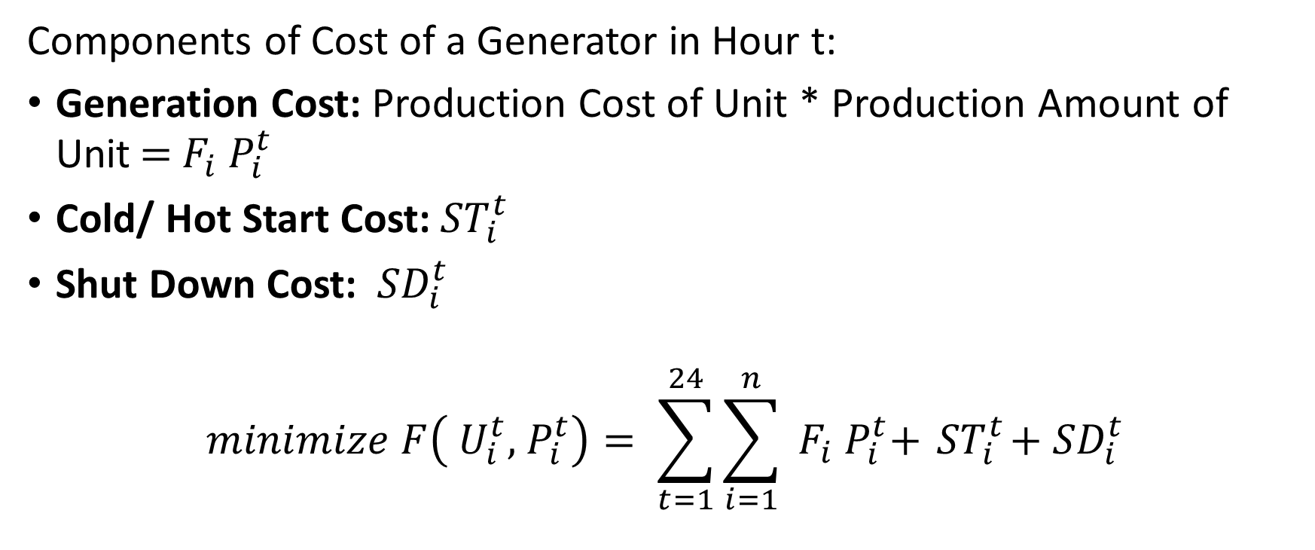
Cost Function
Components of Cost of a Generator in Hour t:
Generation Cost: Production Cost of Unit * Production Amount of Unit$={ F}_{i}{ P}_{i}^{t}$
Cold/ Hot Start Cost:${ ST}_{i}^{t}$
Shut Down Cost: ${ SD}_{i}^{t}$
$$minimize F\left({ U}_{i}^{t},{ P}_{i}^{t}\right)= \sum_{t=1}^{24}{\sum_{i=1}^{n}{{ F}_{i}{ P}_{i}^{t}+}}{ ST}_{i}^{t}+{ SD}_{i}^{t}$$

Slide 5
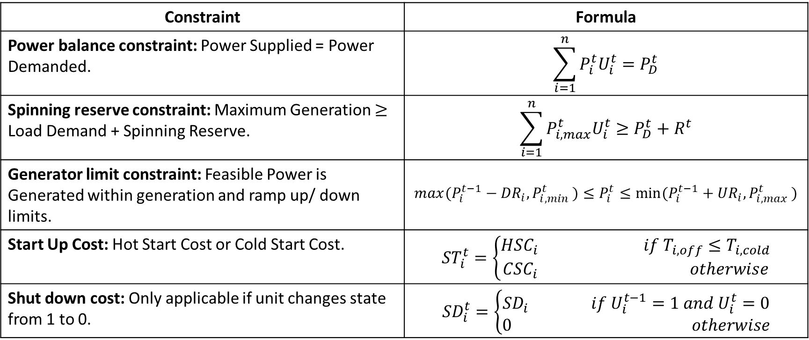
Constraints
Constraint | Formula
Power balance constraint: Power Supplied = Power Demanded. | $$\sum_{i=1}^{n}{P_{i}^{t}U_{i}^{t}=P_{D}^{t}}$$
Spinning reserve constraint: Maximum Generation $≥$ Load Demand + Spinning Reserve. | $$\sum_{i=1}^{n}{P_{i,max}^{t}U_{i}^{t}≥P_{D}^{t}+R^{t}}$$
Generator limit constraint: Feasible Power is Generated within generation and ramp up/ down limits. | $${max(P}_{i}^{t−1}−{DR}_{i}{,P}_{i,min}^{t})≤P_{i}^{t}≤{min⁡(P}_{i}^{t−1}+{UR}_{i}{,P}_{i,max}^{t})$$
Start Up Cost: Hot Start Cost or Cold Start Cost. | $${ST}_{i}^{t}=\left\{\begin{aligned}{HSC}_{i} if{ T}_{i,off}≤T_{i,cold} \\ {CSC}_{i} otherwise\end{aligned}\right.$$
Shut down cost: Only applicable if unit changes state from 1 to 0. | $${SD}_{i}^{t}=\left\{\begin{aligned}{SD}_{i} if{ U}_{i}^{t−1}=1 and{ U}_{i}^{t}=0 \\ 0 otherwise\end{aligned}\right.$$

Slide 6
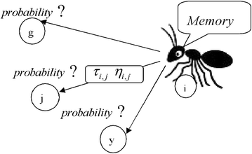
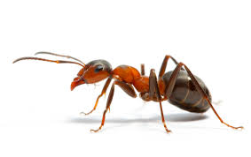
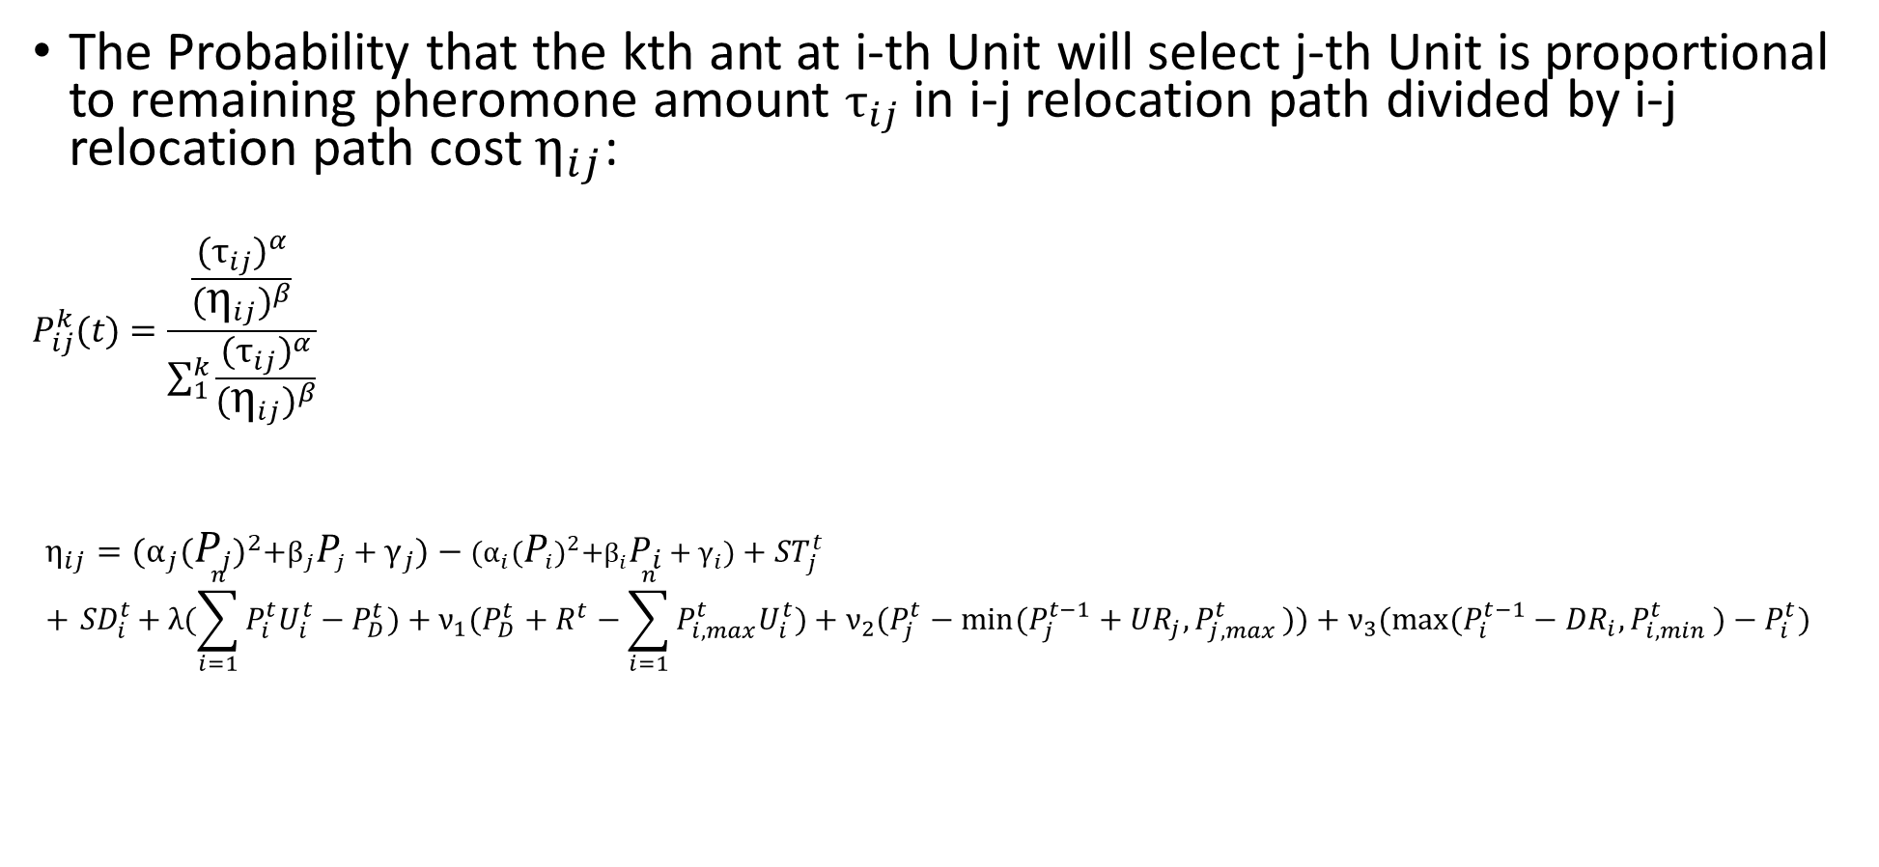
Path Selection
The Probability that the kth ant at i-th Unit will select j-th Unit is proportional to remaining pheromone amount $τ_{ij}$ in i-j relocation path divided by i-j relocation path cost $η_{ij}$:
$$P_{ij}^{k}(t)=\frac{\frac{{(τ_{ij})}^{α}}{{(η_{ij})}^{β}}}{\sum_{1}^{k}{\frac{{(τ_{ij})}^{α}}{{(η_{ij})}^{β}}}}$$
$${η_{ij}={(α}_{j}{(P_{j})}^{2}+β_{j}P_{j}+γ_{j})−{(α}_{i}{(P_{i})}^{2}+β_{i}P_{i}+γ_{i})+ST}_{j}^{t}+{ SD}_{i}^{t}+ λ(\sum_{i=1}^{n}{P_{i}^{t}U_{i}^{t}−P_{D}^{t})+ν_{1}(P_{D}^{t}+R^{t}−\sum_{i=1}^{n}{P_{i,max}^{t}U_{i}^{t}})+ν_{2}(P_{j}^{t}−{min⁡(P}_{j}^{t−1}+{UR}_{j}{,P}_{j,max}^{t}))+ν_{3}({max⁡(P}_{i}^{t−1}−{DR}_{i}{,P}_{i,min}^{t})−P_{i}^{t})}$$

Slide 7
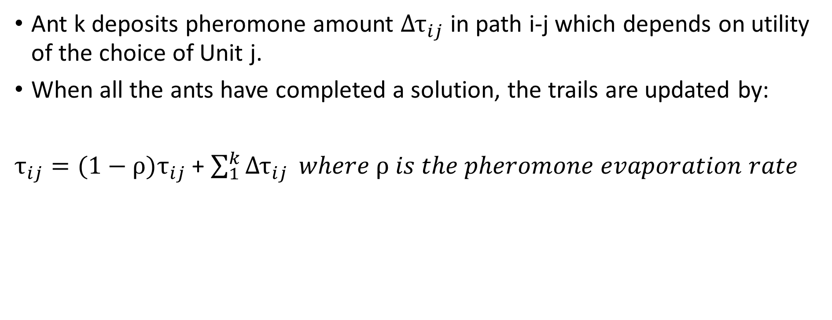
Pheromone Matrix for each hour
Ant k deposits pheromone amount ${Δτ}_{ij}$ in path i-j which depends on utility of the choice of Unit j.
When all the ants have completed a solution, the trails are updated by:
$τ_{ij}=(1−ρ)τ_{ij}$ + $\sum_{1}^{k}{{Δτ}_{ij}} where ρ is the pheromone evaporation rate$
Present i Next j | 1 | 2 | 3
1 | 0.95 | 0.75 | 0.35
2 | 0.05 | 0.15 | 0.00
3 | 0.00 | 0.10 | 0.65

Slide 8
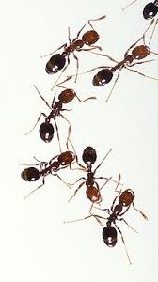

Stop Criterion
If the number of ants passing a path gets more than a minimum amount, the solution is reached.
Ants make optimal transitions and settle at most efficient Generation Units. The steady state Generation Units must be operated for optimal utilization of Power System in that Hour.
The solution ensures that the load demand and all other constraints are met simultaneously while minimizing the cost function.

Slide 9
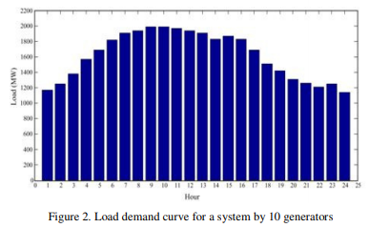
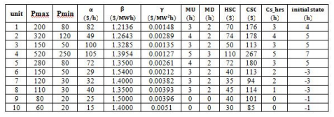

Results
A modified version of ACO algorithm has been developed using MATLAB software for 10 Generator System with 200 ants and $ρ$=0.25.
Load Demand Curve
Characteristics of 10 Generators

Slide 10
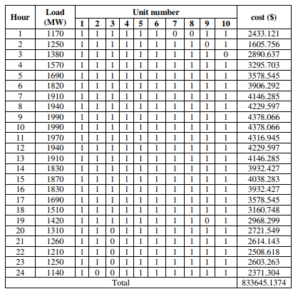
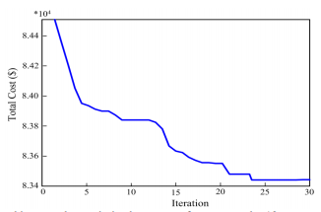
Results
Local Minimum
Global Minimum
Speed of Convergence to Optimal Solution
Optimal Operation Scheme

Slide 11
Future Research
Incorporate Energy Losses/ Transmission Losses of each Generation Unit in Cost Function.
Perform Sensitivity/ Perturbation Analysis by relaxing or tightening some constraints.
Use better penalty functions for violation of constraints, to increase rate of convergence to optimal solution.

Slide 12
References
https://airccse.com/aeij/papers/3316aeij02.pdf

